Slide 1



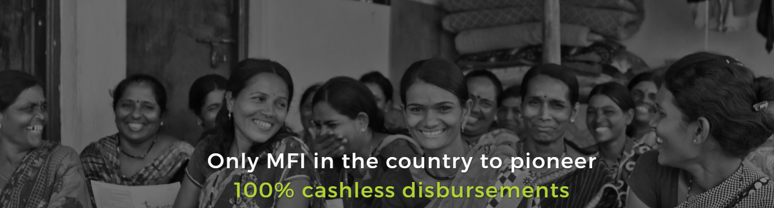
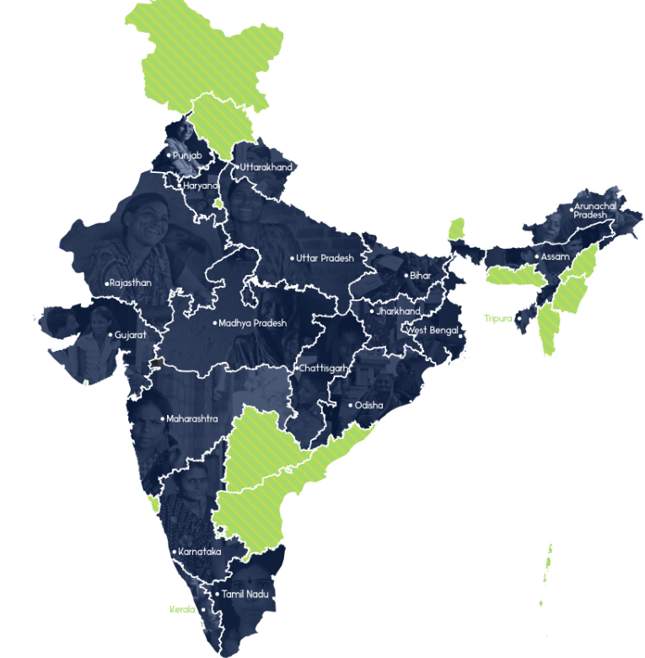

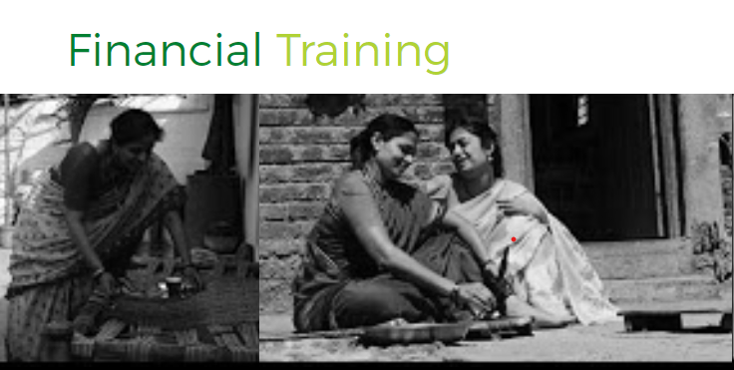

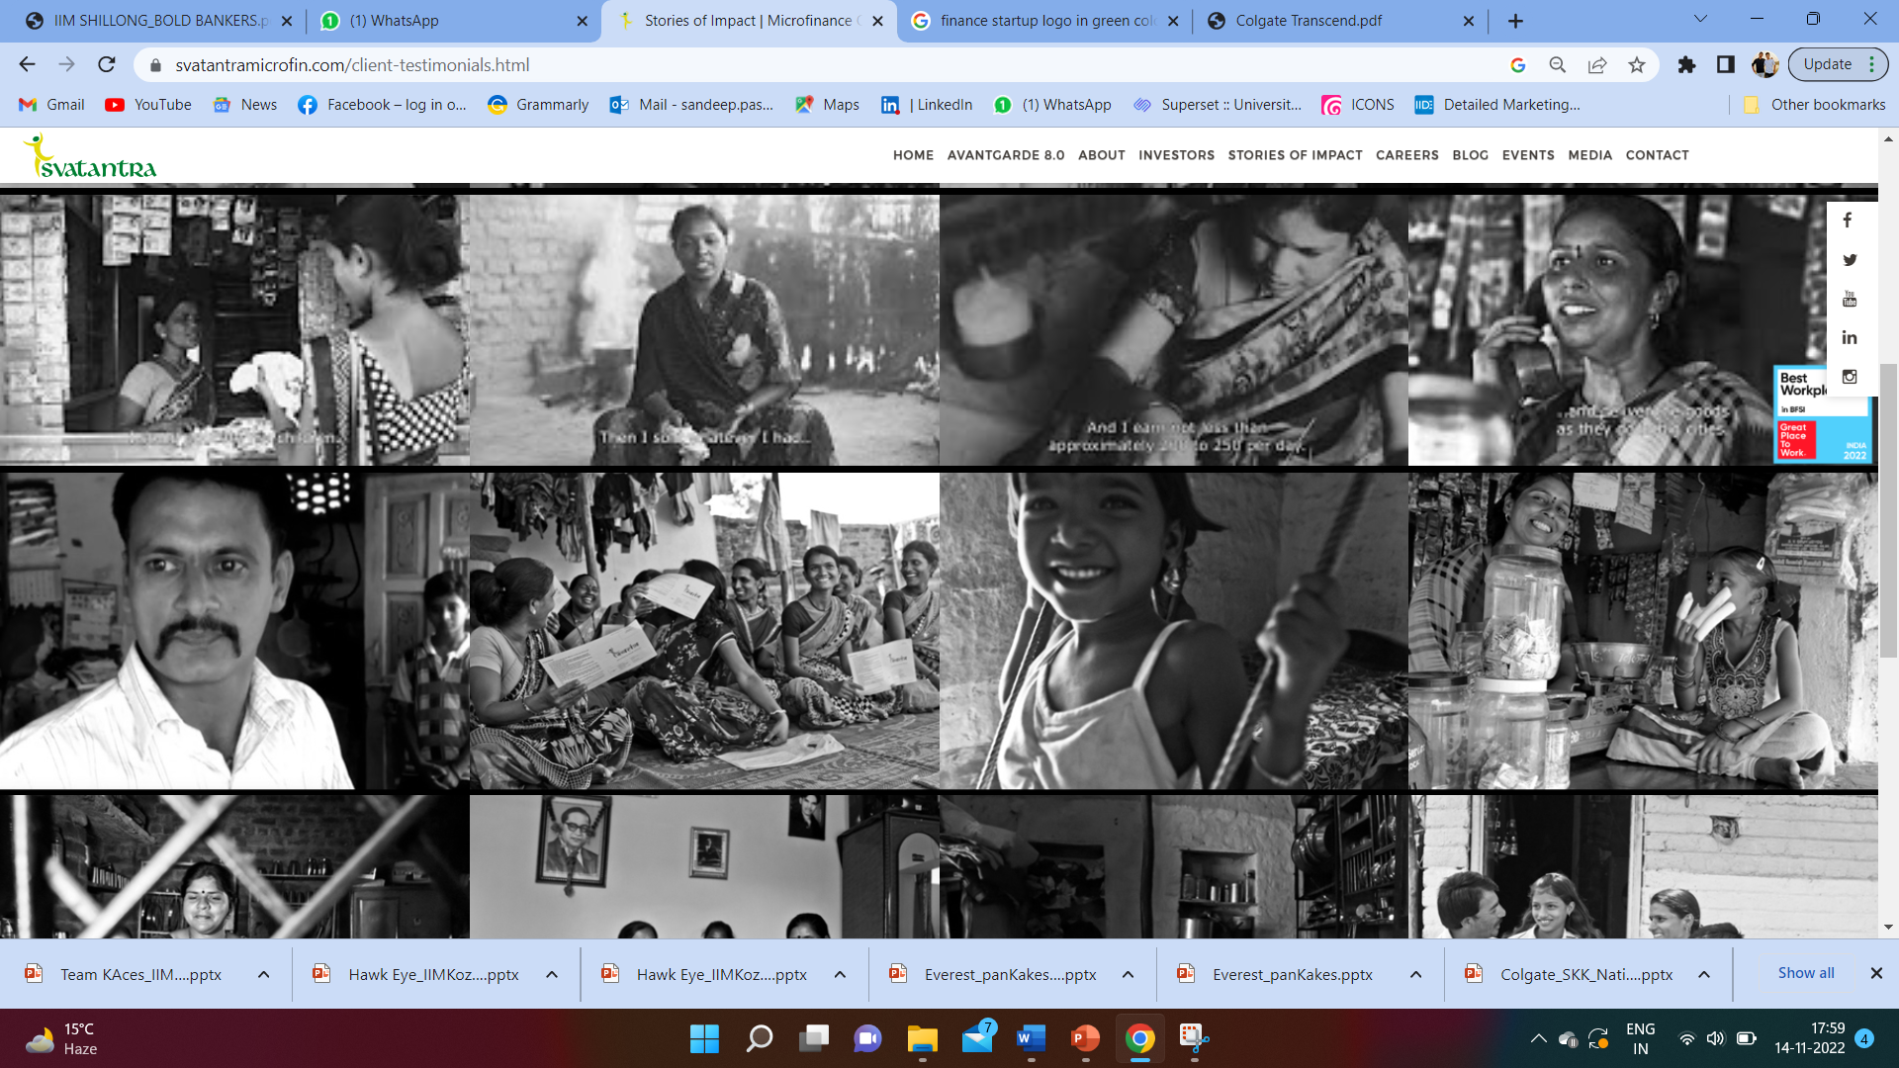


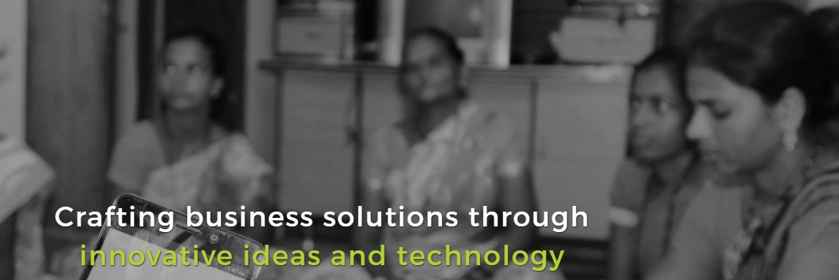


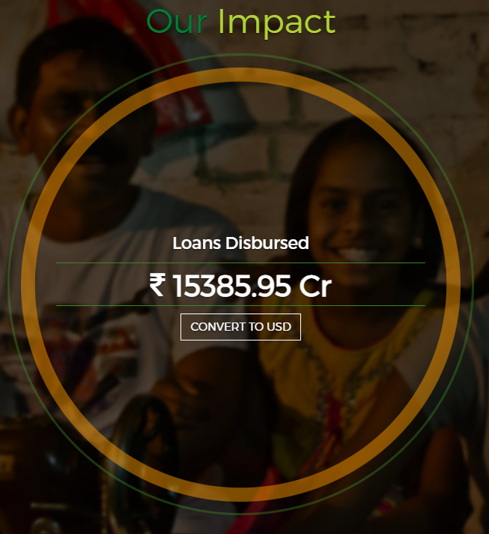
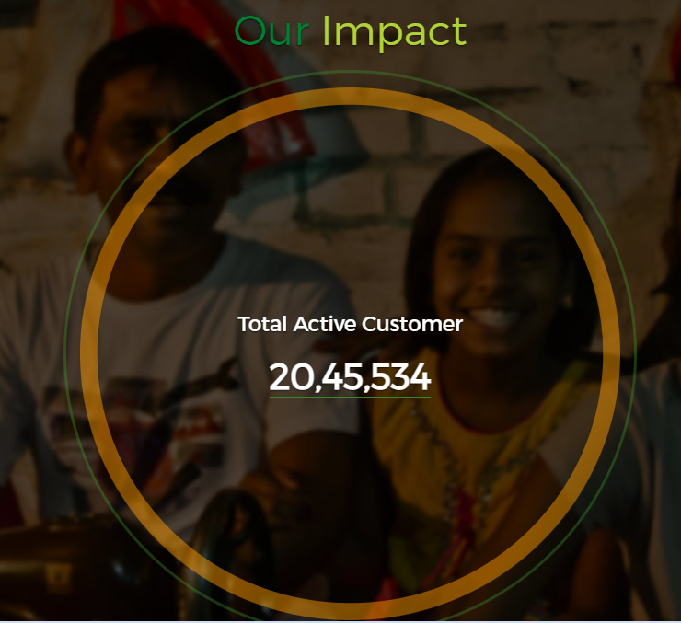
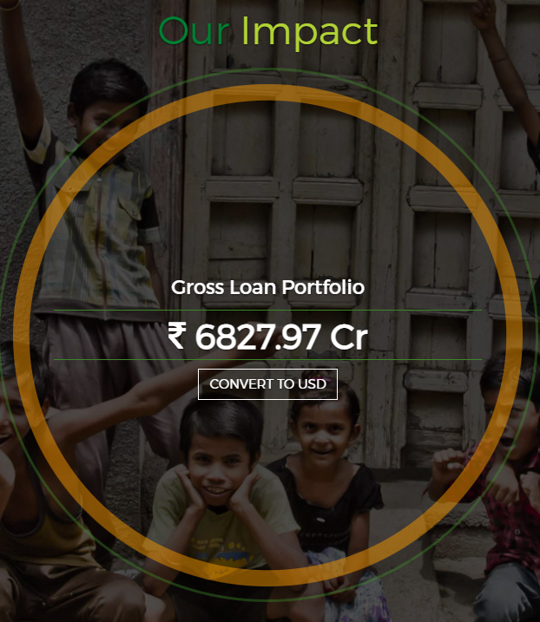








Beyond Credit ‘Creating an Impact in rural India’
AIM:
To improve offering and encourage entrepreneurship by extending banking solution and Financial Inclusion
Help Women in rural village become economically self sustainable by providing Micro- Loans.
COMPANY BANDWITH
Svatrantra Microfinance Presence: 810+ Branches
Available in: 19 States
Current presence: 330+ Districts
Rural Coverage: 90,000+ Villages
Catered 20,45,534 lakh unique Visitors on Website
VISION
Impact Created In Rural India
SOCIAL IMPACTS
-Provide Next-gen Microfinance
-Constant Technology Innovation
-Encourage Entrepreneurship
-Offer Financial and non-financial Micro-Credit
Eradicated hunger, poverty & malnutrition and promoted education among children, women and elderly through Akshay Patra.
Protected and empowered women, fostered humility and gallantry among men through Meer Foundation.
Promoted Socio Economic development of every Child through Aditya Birla Education Trust.
WEST:-Maharashtra, Gujrat, Rajasthan, MP
NORTH-Punjab, Haryana, Uttarakhand
IMPACT STORIES BY SVATANTRA
EAST:-Chhattisgarh, Jharkhand, Bihar, UP, Odisha, WB, Assam, Tripura and AP
IMPACT CREATED BY SMPL
Enabling Entrepreneurship
Offer Financial stimulus through Micro Loans
Leverage Innovation supported by Technology
HOW WE DO IT
SOUTH:- Karnataka, Tamil Nadu, Kerala
Conduct Workshops on financial literacy
Develop money management skills
Payout Money to run business efficiently
Through Financial and Non- Financial offerings
Creating group of 5-12 peoples by field officers
SVATANTRA SAHAYATAH SAMOOH
Offer Timely Guidance
Timely collection of EMIs
Identifying customer's who benefits from Loan.
Through Detailed survey
Detailed Application process to shortlist Potential Customers
Find best idea for Finclusion

Slide 2


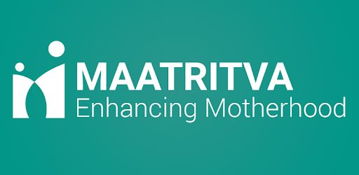














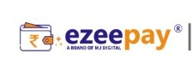








PROPOSED SOLUTIONS
Solution #1 Solution # 2 and 3 Solution # 4 and 5
SECTOR OVERVIEW
MEDIA STRATEGY
HEALTHCARE STARTUPS
EDUCATION STARTUPS
Potential opportunities in different sectors
INCREASE IN DEMAND HAS LED TO MORE MICROFIN-INVESTMENT
HEALTHCARE
FINTECH
Maatritva
ConveGenius
Rural India has a severe shortage of human resources for health and startups are trying to solve this issue by leveraging technology. Significant urban–rural differences in HRH with urban areas having four times greater doctor density than rural areas.
Fintech players are helping, microfinance lenders to reduce their operational costs and reach a larger audience of borrowers without having to hire additional field officers.
Hence potential sector for Microfinance Investment.
Ensuring 100 percent institutional delivery
Bridging the extant learning gaps affordably in India by leveraging technology, and implementing nudged learning from its programs
Niramai
NIRAMAI stands for "Non-Invasive Risk Assessment with Machine Intelligence“
EDUCATION
RURAL UNEMPLOYMENT
Cograd
As 65% of the population of India is situated in rural areas, emphasizing on rural education will help boost the overall economy.
An increased access to credit allows parents to do basic things, like pay fees for better schools, buy uniforms, school supplies.
Building Next Gen Schools
There has been a significant decrease in the Unemployment rate.
The rural development ministry has sought additional funds of about Rs 25,000 crore for the MGNREGS, in a clear indication of a rise in demand for work.
Medyseva
ThinkZone
Get video consultation with city doctors in own village
Providing quality learning opportunities for children in low resource settings
FINTECH STARTUPS
EMPLOYMENT STARTUPS
Facts
Government Schemes
India needs Rs 13.52 lakh cr annual investment to create full employment; a study by The People's Commission on Employment and Unemployment.
Indian edtech startups have received total investment of US$ 3.94 billion across 155 deals in FY22.
Healthcare industry in India is projected to reach $372 bn by 2022
Rural Education: Samagra Shiksha, Shiksha Karmi Project,
Lok Jambish Pariyojana, Digital initiatives
Health Care: National rural Health Mission, Ayushman Bharat, Janani Shishu Suraksha Karyakram
Fintech: Pradhan Mantri Jan Dhan Yojana (PMJDY), Pradhan Mantri Mudra Yojana
Rural Employment: Pradhan Mantri Gram Sadak Yojana (PMGSY), Pradhan Mantri Awaas Yojana Gramin, Mission Antyodaya
Mimo
Avail Finance
India’s 1st neo-bank for next billion users
Making Lives Better With Digital Skilling & Financial Inclusion
Ezeepay
Banking for the new Bharat.
Insuring the digital Bharat
Make your shop
Mini ATM
Frontier Markets
Building Customer Loyalty, At Scale
Gram Cover
GoCoop
Bridging the Gap Between Insurance & Rural India
Rural India’s Gateway to Insurance
Global marketplace for handlooms & crafts of India
Banking for the new

Slide 3






PROPOSED SOLUTIONS
Solution #1 Solution # 2 and 3 Solution # 4 and 5
Pain Point
HEALTHCARE
To tap the rural healthcare market through the Integration of Healthcare start-ups.
EDUCATION
Serve the unserved by providing Micro- Finance to parents and Start-ups for better education.
About Company
Social Impacts
About Company
Social Impacts
Maatrivita (Mobile Health platform)- Aims to prevent complication in Pregnant Women
Through Screening, Identification and tracking of High-risk pregnancy
NIRAMAI- Detects breast cancer at much earlier stages
Automated, portable cancer screening tool
Medyseva- Focused on Telemedicine in rural India.
Nearest, Affordable, healthcare destination for rural.
Creating innovation using digital Technologies
Increase in Tech literacy of ANMs among Women
ConveGenius- Edtech Social Enterprise focused on educational equity& Learning
Bridging learning & Skill gaps
Cograd- Building Next Gen schools in Unreached India
Interactive and career oriented Learning approach
ThinkZone- Social Enterprise improving learning in low-resource setting.
Utilizes offline-enabled mobile application solutions for training and equipping youth to become educators.
Positively impacted 5.4L+ and Serve in 16 States Sustainable education by utilizing adaptive tech & Nudged learning
Conducted 70000+ screening in rural India
Catered 300+ rural doctors providing treatment to 1000+ Covid Patients.
- Collaborated with 25+ rural schools & Conducted 100+ Workshops. - Skill based Education at lowest cost
Bridging Gap between Urban doctor and rural Patient
3500+ consultations covering 23+ specialties through 50+Medyseva Kendra
- Supported 3,000+ educators and improved lives of 30,000+ students, Notable gains in language & arithmetic scores. - Made more kids school ready & generated income for youth
Partnership
Partnership
To expand the reach and scope of Svatantra Mediclaim we can partner with Maatrivita, NIRAMAI, Medyseva to better cater the rural Health care ecosystem.
Unique partnerships to solve healthcare problems of rural India
Cover all major health complications under Svatantra Mediclaim by partnering with these start-ups.
To partner with ConveGenius, Cograd, Thinkzone for providing better education and Micro- finance facilities.
Strengthening the rural education ecosystem and better education facilities.
KPIs

Slide 4


PROPOSED SOLUTIONS
Solution #1 Solution # 2 and 3 Solution # 4 and 5
About Company
Social Impacts
Social Impacts
About Company
EzeePay - Aims to make banking easier & more convenient in rural areas of India.
Offers 60+ services like domestic money transfer, mobile recharge, insurance, taxation, etc.
Avail Finance - Indians get instant online loan app built and have access to Personal loan anytime anywhere Avail’s low interest loans, helps them build a credit history through timely, simple repayment.
Gram Cover - Insurance broking firm focused on insurance product design and tech-enabled distribution for rural India.
Well- suited for rural setup to minimize the inefficiencies and transaction costs
- 65K Average Annual INR Net Income earned per woman - 4000 Villages Covered - 19.5MN Products Sold
- 5 lakhs+ retailers - 5 crore+ customers served - 10000+ Pin codes served - 2 Lakh - Avg financial transactions per day
Frontier Markets- social commerce platform with a mission to create 'Saral Jeevan’.
Investing in rural women entrepreneurs as our connector to rural communities.
MIMO- provides last mile delivery and task associate solutions across India.
GoCoop - Connects artisans, weaver co-operatives and clusters directly with consumers across the world
Works to support sustainable livelihoods for India’s 10 million weaver and artisan community
- 1.2M+ micro job opportunities created for the people in need - $14M+ disbursed as wages to Gig workers - 65K+ trainings done for Digital Skill development
- 100K+ happy customers - 2000+ Smart Agents - 4500+ villages
-
22,000+ Villages
- Covered 2 million+ Customers
Enrolled 1 Million+
Claim Settled 4000+ Local Partners
30,222 livelihoods supported (as of Mar ‘21) INR 27,557 average additional income generated per income 70,000+ products sold to 100,000+ consumers
Partnership
Partnership
We can partner with fintech start-ups like EzeePay, Avail Finance , Gram Cover. We can utilize their technological innovation to improve our competitiveness and better serve consumer needs.
We can partner with employment providing startups like Frontier Markets, MIMO & GoCoop to provide credit facility for education and hep better lives in rural India.
We can provide financial support to the rural people selling their products on platforms like GoCoop and Frontier Markets
The cooperation between microfinance industry and Fintech can be seen as a direction toward a strategic development.
KPIs
This Photo by Unknown Author is licensed under CC BY-SA-NC

Slide 5

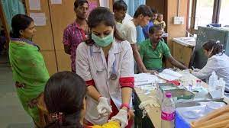

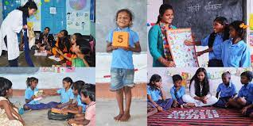

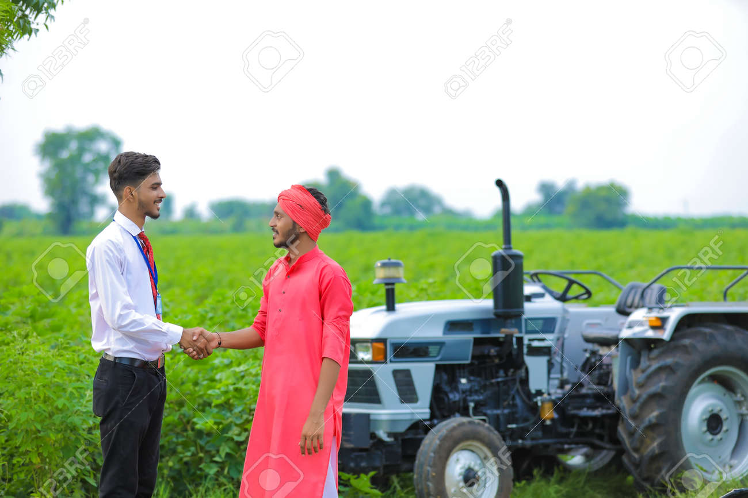

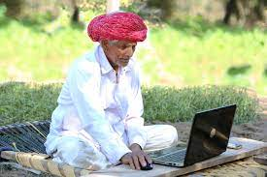




PROPOSED SOLUTIONS
Solution #1 Solution # 2 and 3 Solution # 4 and 5
Enhancing SMPLs Valuation through Partnering with Startups
HEALTHCARE STARTUPS
EDUCATION STARTUPS
FIN-TECH STARTUPS
EMPLOYMENT STARTUPS
 | AWARENESS | INTEREST | CONSIDERATION | PURCHASE
MAATRIVITA
CONVEGENIUS
EZEEPAY
FRONTIER MARKETS
Expand the scope of Svatantra Mediclaim to increase market share in Health insurance
Provide insurance coverage for pregnancy complication and increase its rural presence
Provide Micro-finance to Tech based solution and enter into to technology driven education sector
Provide affordable education solution to parents with the help of SMPL.
Be the Banking partner with Ezeepay to provide Micro-fin support in Banking/ Insurance facilities.
Leverage network of 5L+ agents to penetrate further into rural India
SMPL can provide Micro-fin to Rural Entrepreneurs to sell , grow and scale with Frontier Markets Phygital Infrastructure.
Can connect with 21K+ rural women of FM salesforce and solve unemployment issue in rural India.
BENEFITS
NIRAMAI
COGRAD
AVAIL FINANCE
MIMO
Leverage Niramai software based technology to strengthen the Svatantra Mediclaim.
Integrate with Niramai to increase presence and provide micro finance to solve breast cancer in rural India
Provide Financing to build next generation Schools in Unreached India.
Expand its reach to Untapped 15000+ students across India through Cograd startup.
Leverage Avail Finance’s instant loan app to further improve loan portfolio of SMPL. by providing personal loan instantly. Facilitate smooth transition of customers from Avail’s instant personal loan to SMPL’s wide loan offerings once the CIBIL score of customer improves.
Provide Micro-Fin solutions to strengthen inclusive growth by offering job opportunities, digital training etc.
Helps Gig workers to provide digital learning experience with Entrepreneurial Mindsets.
OF
MEDYSEVA
THINKZONE
GRAM COVER
GOCOOP
Partner with gram cover to expand SMPLs insurance portfolio to Life, Motor, Crop and Livestock’s.
Leverage on its Assisted Tech Model for Customised products and POSP partnership.
Through Gocoop, SMPL can provide Financing to Local Artisans and Handloom workers to produce hand made natural and sustainable products.
Support sustainable Livelihood by empowering rural Industries.
LEVERAGING WITH SMPL
Medyseva: Leverage on Medysevas focuses on telemedicine with art of Tech.
Help Medyseva bridge gap between urban doctors and rural patients by providing micro-fin solution in rural areas.
KPIs
Thinkzone: SMPL can help mentor youths in under resourced communities to become Micro- Entrepreneurs.
Provide Financing to support learning for children's aged 3-10 yrs. category.

Slide 6
Rural education is the yardstick of a nation’s development. Rural education plays a pivotal role in resolving many of India’s key problems – youth disillusionment, poverty, crime to name a few.
Rural education is an untapped market and because of government’s focus and support to it, it offers good opportunities to private players as well. Literacy rate in rural India it is only 73.5%.
The important socio-economic objective of enhancing “financial inclusion” in India has been governments’ focus Because of government support for this, it offers good opportunity to private players to serve this untapped market.

Slide 8
PROPOSED SOLUTIONS
Solution #1 Solution # 2 and 3 Solution # 4 and 5
India’s population was taken and various filters regarding age, income, preference for E/PTB were taken to arrive at opportunity size for year 2021.
Secondary Research
India is the world's oral cancer capital; 60% of the population is affected by dental caries and 85% by periodontal disease
Only 12.4% of adults have ever got their oral cavity examined by a dentist as per National Oral Health Policy 2018
Ensure proper availability of refills alongside toothbrushes to drive sales and enable loyalty.
Ensure proper availability of refills alongside toothbrushes to drive sales and enable loyalty.
Increase awareness about product segment among parents and their children to initiate E/PTB adoption.
Ensure proper availability of refills alongside toothbrushes to drive sales and enable loyalty.
Urban Working Adult Population Poor oral health has been linked to cancer, cardiovascular disease,
Alzheimer’s and birth complications
1 in 5 adults suffer anxiety; 38% shun social activities and believe life is less enjoyable due to poor oral health
Leveraging digital and precision marketing to access target customers.
Ensure proper availability of refills alongside toothbrushes to drive sales and enable loyalty.
Swiftly capture existing vacuum of improved oral health for children’s category
Kids/Teens
Early childhood tooth decay has been linked to developmental delays and possibly disability and death.
The FDI estimates that 70% of Indian children have untreated dental caries
Ensure proper availability of refills alongside toothbrushes to drive sales and enable loyalty.
Increasing awareness about the cleaning effectiveness of E/PTBs, particularly the sonic technology.
Ensure proper availability of refills alongside toothbrushes to drive sales and enable loyalty.
Opportunity Size by 2025
44.97 Cr PTB Market
44.97 Cr PTB Market
44.97 Cr PTB Market
44.97 Cr PTB Market

Slide 12
56

